Slide 1

The template Design Pattern

Slide 2
The Template Pattern Structure

Slide 3
public abstract class AbstractClass
{
final void templateMethod()
{
primitiveOperation1();
primitiveOperation2();
concreteOperation();
}
abstract void primitiveOperation1();
abstract void primitiveOperation2();
void concreteOperation()
{
//Implementation
}
}

Slide 4
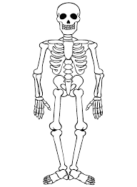
The template design pattern as a skeleton of an algorithm in a method.

Slide 5
When are we using this pattern?
When we have a preset format or steps for algorithm but the implementation of steps may vary (so the subclasses are going to implement behavior.
When we want to avoid code duplication, implementing common code in the base class and variation in subclasses.
The template method is a technique for code reuse, it forces you to figure out common behavior and defer specific behavior to subclasses.

Slide 6

What are the components of the pattern?
Abstract class: This is the super class, here we are going to form the skeleton (or the structure of our algorithm).
This class also defines the abstract operations that will be implemented by the subclasses to define the steps.
Concrete class: it implements the abstract operations of a super class to be carried out and overrides operations if the default behavior is not required.

Slide 7
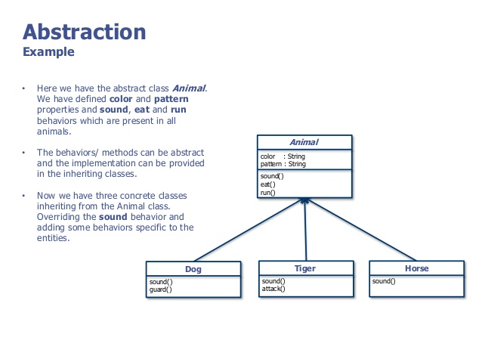
Examples for abstract class and a concrete class.
Abstract class
Concrete classes

Slide 8
The template in the upper class follows “The Hollywood principle”
So the upper class will tell the subclasses what methods they have to implement.
The upper class decides if the subclasses have to override the default behavior.
In the template pattern the abstract class is the high-level component and the concrete classes the low-level components.

Slide 9
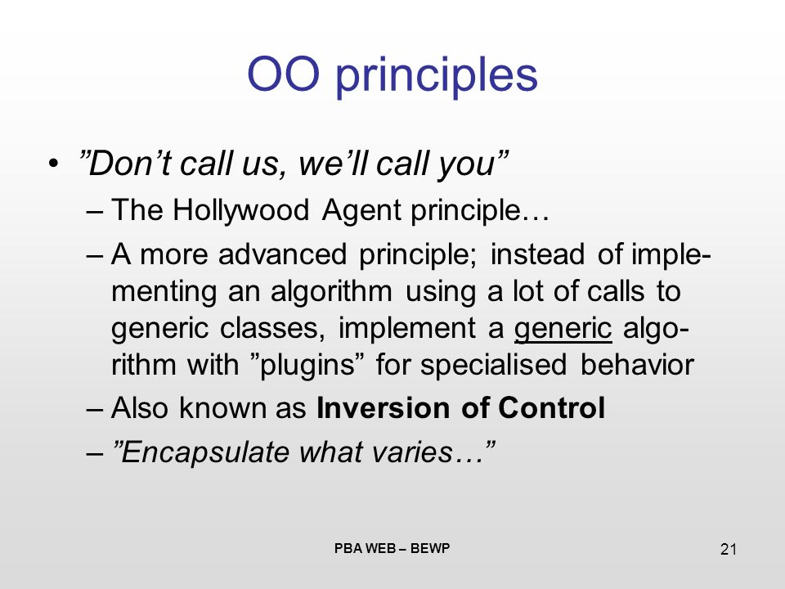

The template in the upper class follows “The Hollywood principle

Slide 10
The template uses inversion of control
The template design is frequently used in frameworks, what an excellent example is for inversion control.

Slide 11
To keep it easy, what does inversion of control?
With traditional programming, the program is going to tell what the framework or the program is going to do.
When we are using inversion of control, the framework is going to ask the program how to execute some task. So in this case, the framework uses only the code he needs.
Inversion of control is responsible for the modularity of the program and makes it extensible.

Slide 12

In the template pattern, you’ll find something called as customization hooks.
Customization hooks are methods containing a default implementation that can be overwritten in other classes.
The hook methods are intended to be overwritten, this is the difference between concrete methods.
The problem with using hook methods is that it becomes very hard to differentiate between hook methods and concrete methods.

Slide 13
Why Hooks?
The number of abstract methods used must be minimized.
Enables a subclass to implement an optional part of an algorithm.
Enables a subclass to react to a step in the template method.
Enables the subclass to make a decision for the abstract class.

Slide 14
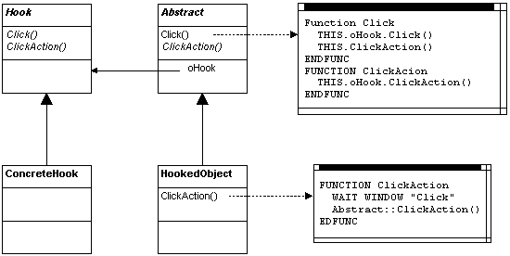
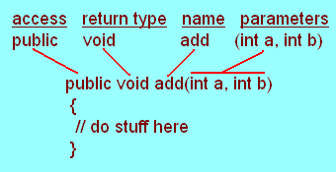
Example between hook method and concrete method
Hook Method
Concrete method

Slide 15
Making a sandwich
Sandwich
Making sandwich +Cut bun +add meat +add cheese +add veggies +add mayo +add egg +add oil ….
Italian Sandwich
+add meet +add cheese +add veggies +add oil

Slide 16
Making a sandwich
Sandwich
Making sandwich +Cut bun +add meat +add cheese +add veggies +add mayo +add egg +add oil +want meat? +want cheese? +want veggies +want oil? +want mayo? ….
Italian Sandwich
+add meet +add cheese +add veggies +add oil +want meat? +want cheese? +want veggies +want oil?

Slide 17
Example
A template method is defined inside an abstract class:
public abstract class AbstractLogger {
/*
* Template method, made final to make
* sure the flow is not modified by subclasses
*/
public final void logMessage(String msg) {
msg = preProcess(msg);
writeToLog(msg);
}
/*
* Abstract primitive operation that must be
* implemented by subclasses
*/
protected abstract void writeToLog(String str);
/*
* Hook method that can be optionally overriden to
* modify the template method's behaviour
*/
protected String preProcess(String str) {
return str; // default behaviour: do nothing
}

Slide 18
Concrete subclasses make use of the hook-method to augment behaviour:
public abstract class TerminalLogger extends AbstractLogger {
/*
* This primitive operation must be implemented
*/
protected void writeToLog(String str) {
System.out.println(str);
}
/*
* Override super.preProcess() to modify behaviour
* of the template method
*/
protected String preProcess(String str) {
return str.toLowerCase();
}
}

Slide 19

Questions?

